Slide 1


ABBOTTABAD UNIVERSITY OF SCIENCE AND TECHNOLOGY
Department of computer Science
Object Oriented Programming
Project
Name: Hassan toufeeq
Roll Number: F24-606
Class: BSSE 2nd C
Submitted to: Mr. Jamal Abdul Ahad
Date: 17 Jun, 2025

Slide 2
📄 Project Documentation Report
Project Title:
Student Result Management System
📚 Table of Contents:
Introduction
Objective
Modules Description
Technologies Used
System Requirements
Installation & Setup
Database Design
Screenshots
Conclusion

Slide 3
🔰 Introduction
The Student Result Management System (SRMS) is a desktop-based GUI application that allows administrators to manage courses, student details, and student academic results. It includes features to view reports, count records, and perform database operations in an easy-to-use graphical interface.
🎯 Objective
The primary objective of this system is to:
Simplify student data and result management.
Provide easy and quick access to academic information.
Avoid manual work and reduce errors in student grading and course tracking.

Slide 4
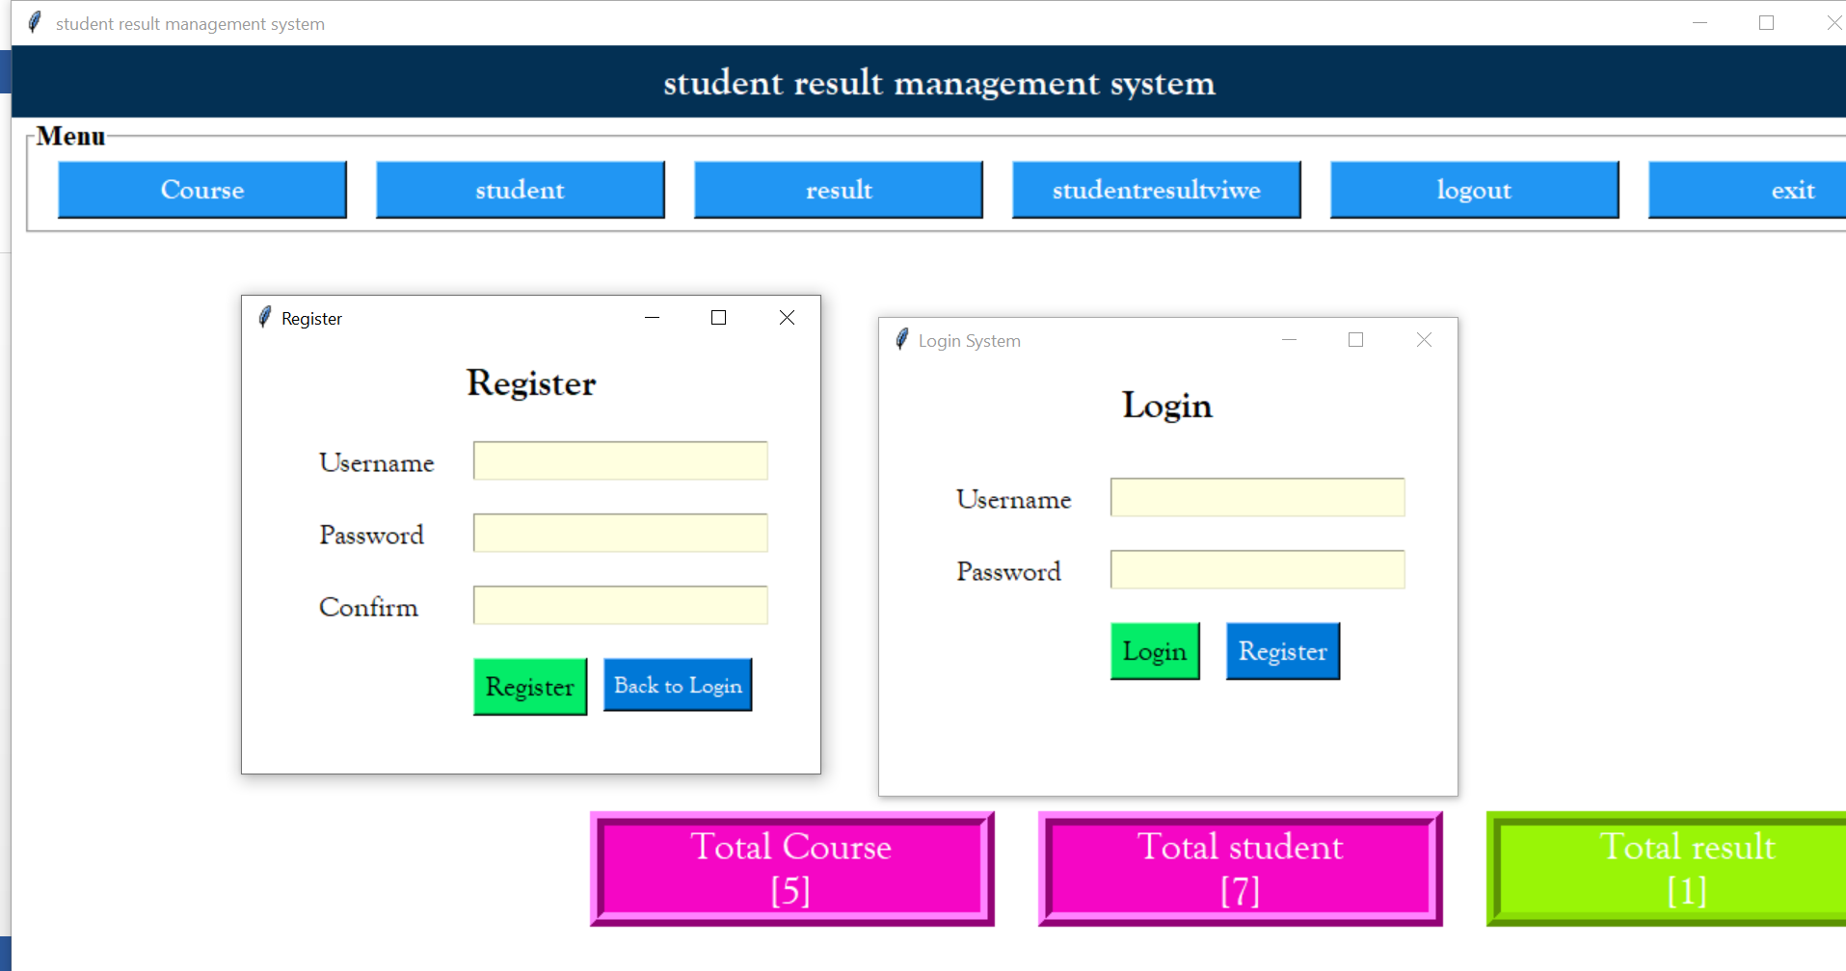
Modules Description
1. Login & Register
loin.py, regsiter.py
Handles admin login and user registration.

Slide 5
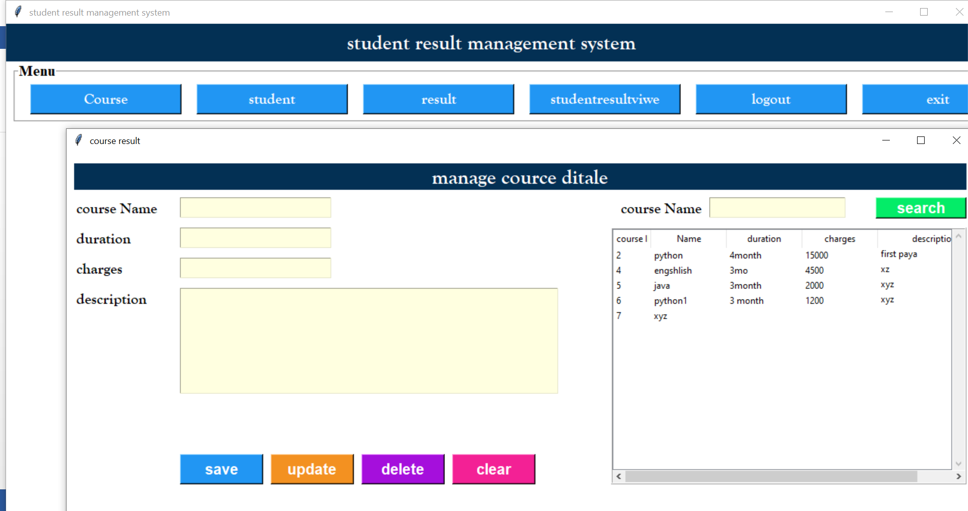
2. Course Management
course.py
Add, update, or delete course details.

Slide 6
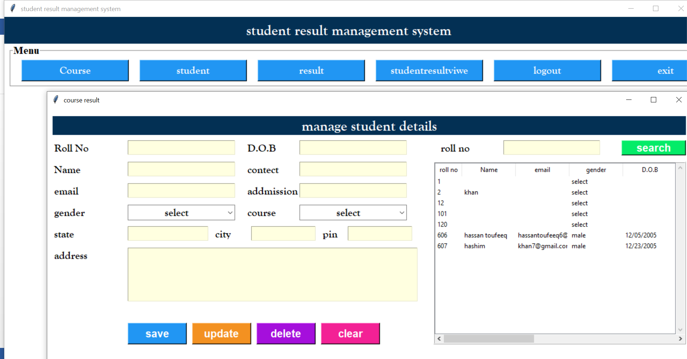
3. Student Management
student.py
Add student data including name, roll number, email, gender, etc.

Slide 7
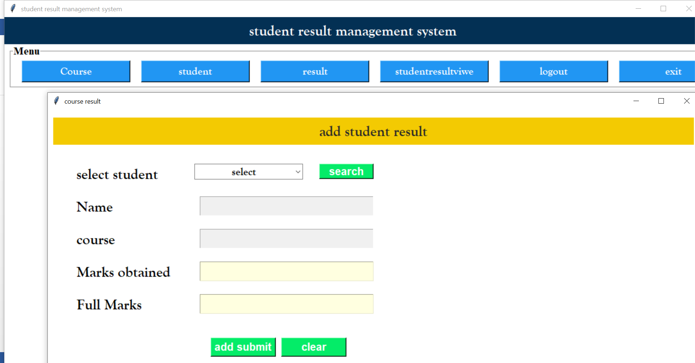
4. Result Management
result.py
Enter and manage student scores, grades, and performance evaluations.

Slide 8
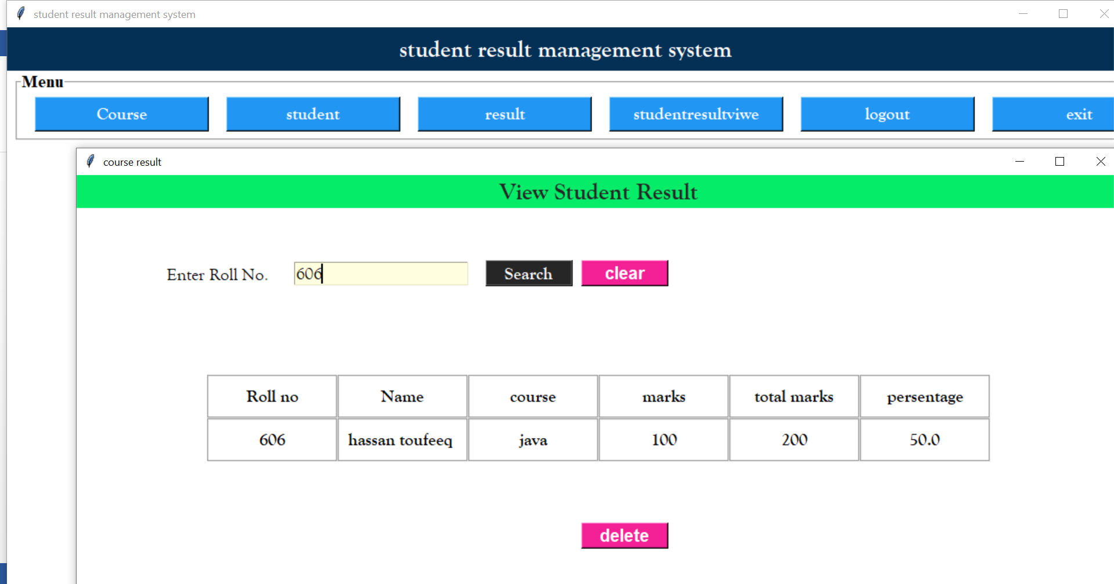
5. Report View
report.py
View all student results in a report format.
Search student result by roll number.

Slide 9
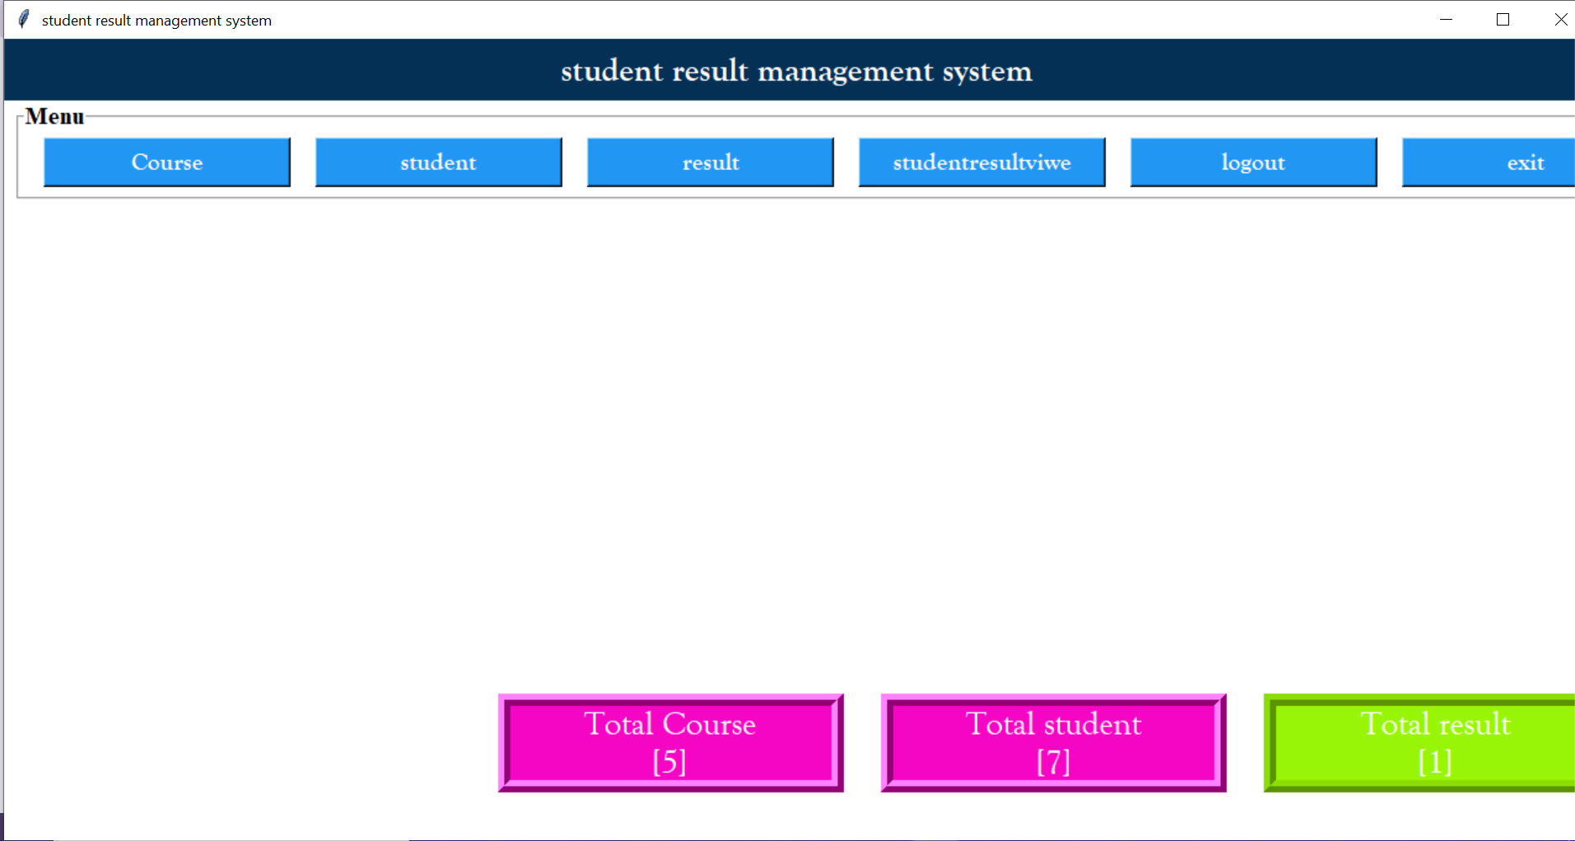
Dashboard:
Top menu with navigation buttons.
Summary cards showing total courses, students, and results.

Slide 10
🗃 Database Design
Table Name | Fields
course | id, name, duration, charge,description
student | roll, name, email, gender, dob, contact, course
result | id, roll, name, course, marks_obtained, full_marks, percentage

Slide 11
✅ Conclusion
This Student Result Management System provides an efficient and user-friendly interface for managing academic records. It reduces paperwork and manual effort by digitizing course and result management. The modular approach ensures easy maintenance and scalability.

